Slide 1

Sir M. Visvesvaraya Institute of Technology in Bengaluru, Karnataka
International Airport Road, Hunasamaranahalli, Yelahanka, Sir M Visvesvaraya Inst Rd, Yelahanka, Bengaluru, Karnataka 562157

Slide 2
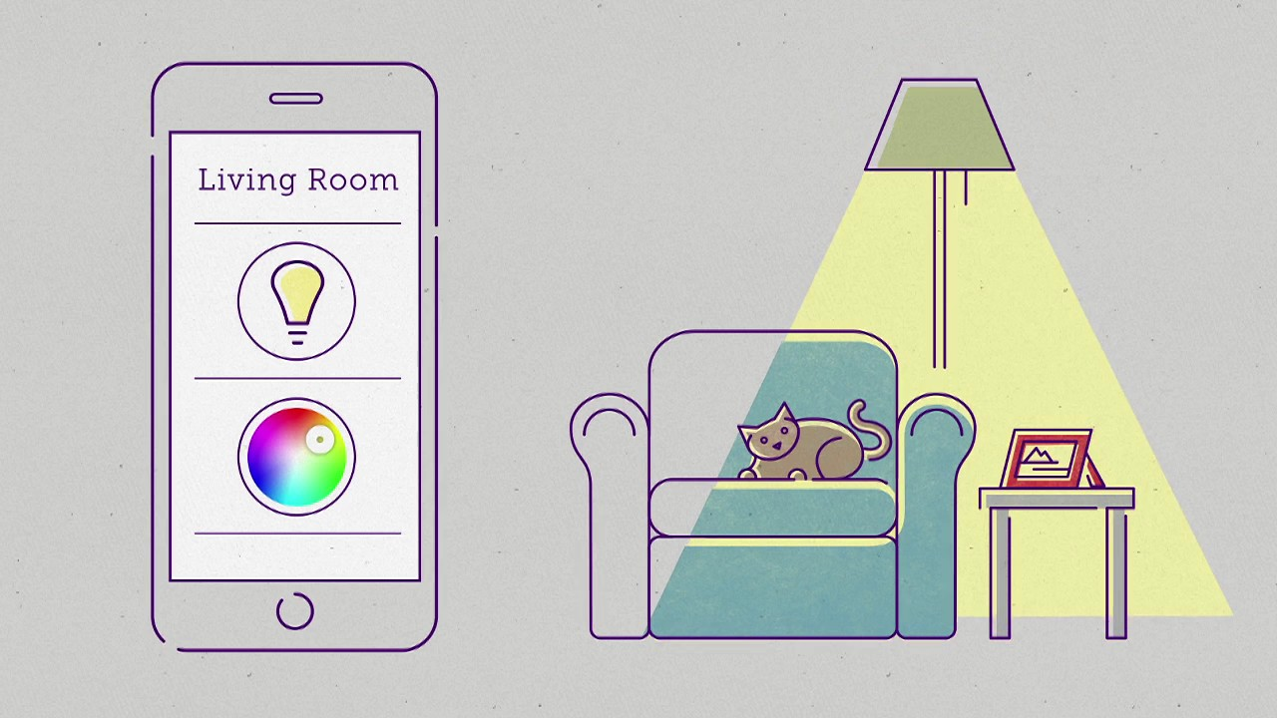
project name Smart home lightning System
6th semester , ece
name: MALIK LALJI usn:1MV19EC065
name: SONAL JHA usn:1MV19EC108
under the guidance of
manjuvani k m

Slide 3
content
Abstract
Introduction
Why you need a smart home lighting system
Objective
Components Required
Components Connection
Architecture
Output
App
Advantages
Disadvantages
Future Development of the project
Conclusion

Slide 4
Abstract
We aim to improve environments in the home in a smart and efficient fashion To design a system using an Arduino board and Bluetooth connectivity to control ambience in the house and provide a comfortable, private, economic solution.

Slide 5
Introduction
Smart Home is the term commonly used to define a residence that integrates technology and services through home networking to enhance power efficiency and improve the quality of living
The smart home lighting system is preferred because of the fact that the lights can be remotely controlled, can play music if needed and also help you sleep better
The smart home lighting system makes use of an Arduino with Bluetooth that will connect to an Android phone via our app and will be controlled by the app

Slide 6
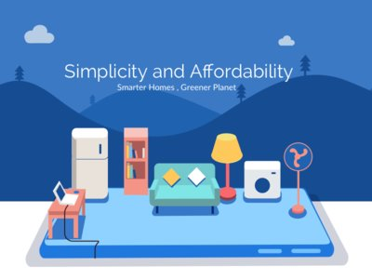
Need of Smart home Lighting System
Efficiency
Convenience
Comfort
Peace of Mind
Customization

Slide 7
0BJECTIVE
CONTROL LIGHTS : This project is one of the important Arduino Project. Arduino based Home Automation using Bluetooth project help the user to control any electronic device using device control app on their Android smartphone. The Android app sends commands to the controller – Arduino, through wireless communication namely, Bluetooth. The Arduino is connected to the main PCB which has 3 LED’s attached as shown in the block diagram. This LED’s can be assumed as electronic devices. Let us assume LED 1 as buzzer, LED 2 as fan, LED 3 as lights.When the user presses the on the ‘On’ Button displayed on the app for the device 1 the Buzzer is switched on. This Buzzer can be switched off by pressing the same button again. Similarly when the user presses on the ‘On’ button displayed on the app for the device 2 , the fan is switched on. The fan can be switched off by pressing the same button again.This project of home automation using Bluetooth and Arduino can be used for controlling any AC or DC devices.

Slide 8
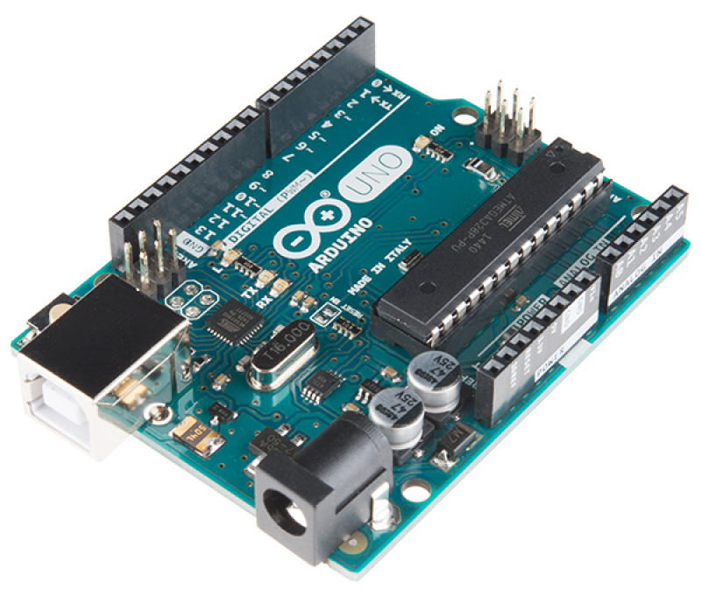
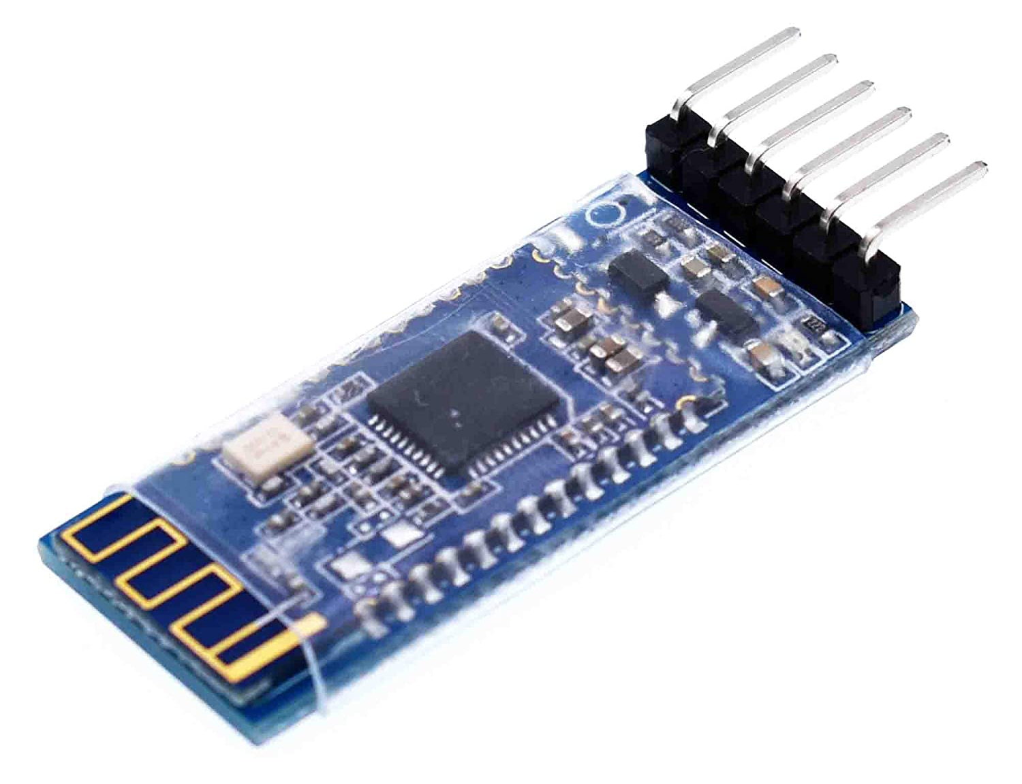
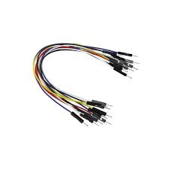
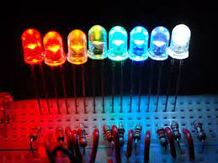
Components Required
Arduino UNO R3
Bluetooth module
LED’s
Power Supply
Jumper Wires

Slide 9
Component Connection
Components | Arduino Uno pin Connection
HC 05 Bluetooth Module | TXD – pin 0
 | RXD – pin 1
 | V_{cc} – V_{cc}(Arduino)
 | GND – GND(Arduino)
LED | Pin 3
 | Pin 4
 | Pin 5

Slide 10
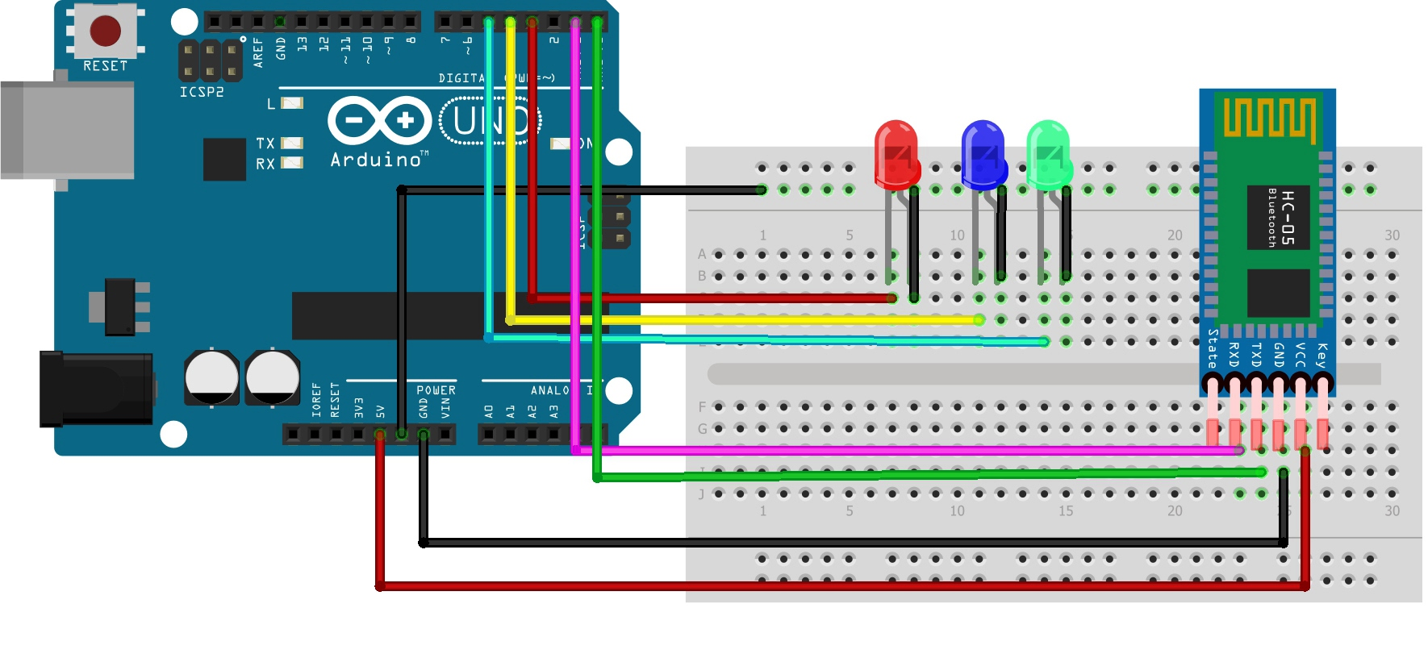
Architecture

Slide 11
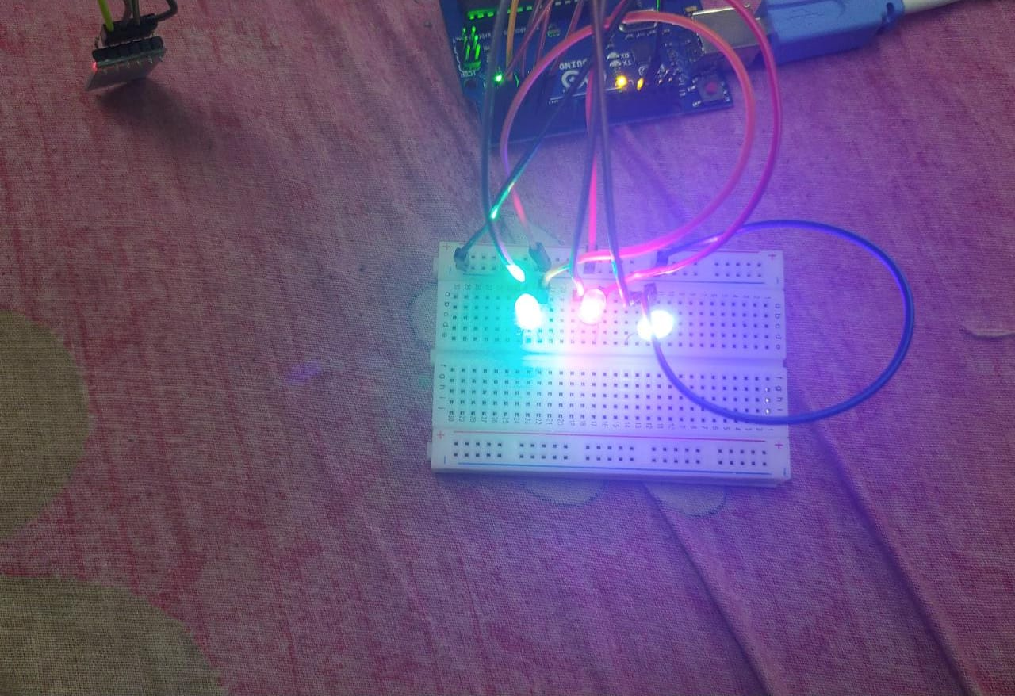
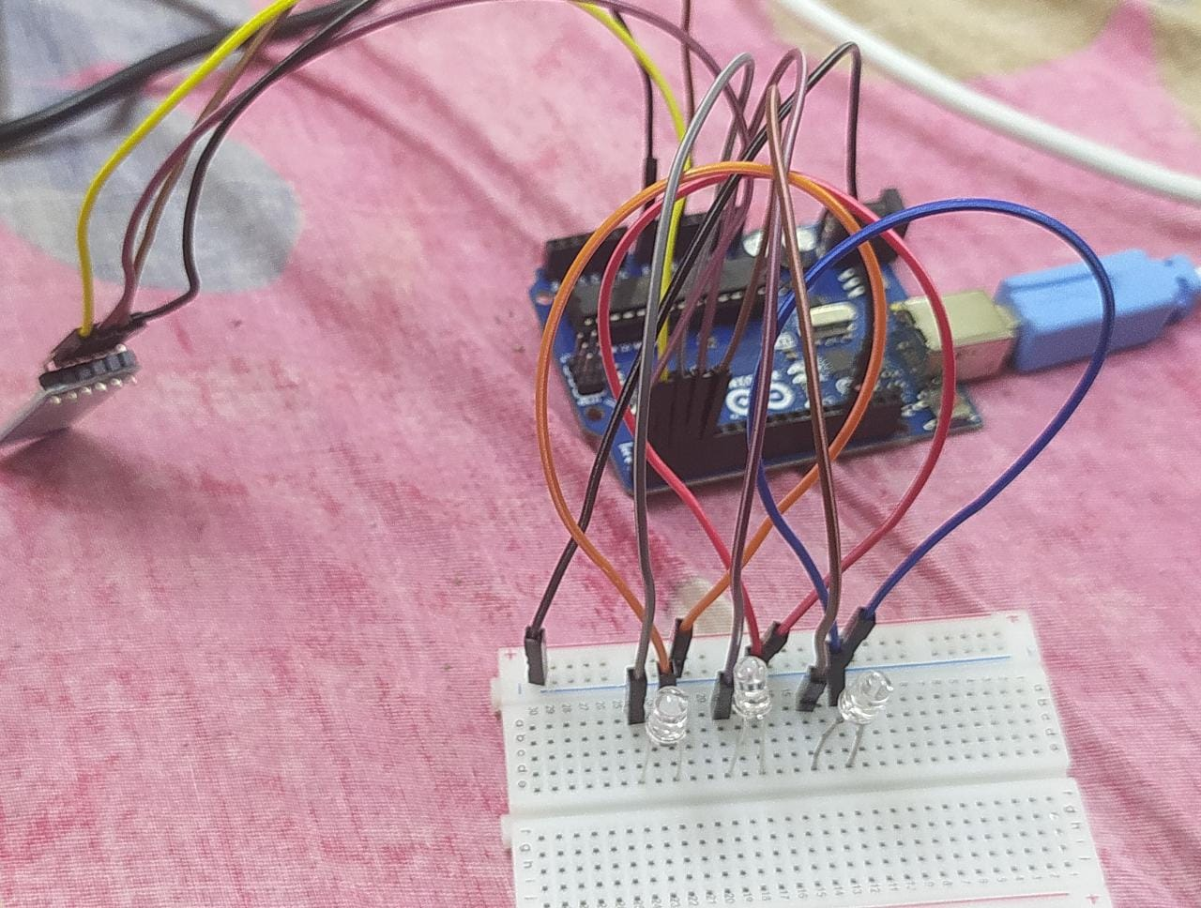
Output

Slide 12
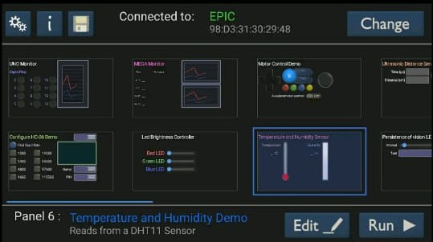
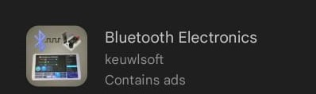
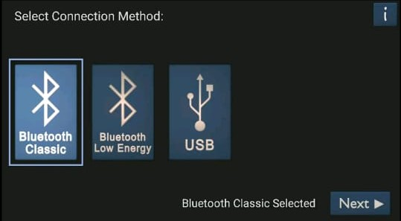
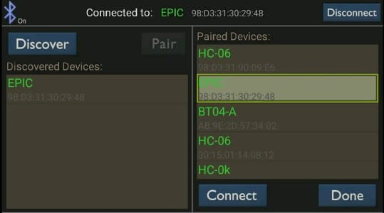
App

Slide 13
advantages
Low cost
Secure
Remotely controlled
it can also help the handicapped and old aged people to control the home appliances without any difficulties
reduces human efforts

Slide 14
disadvantages
Range is much lower and cannot be accessed with much distance
anyone can access the system which might be an issue for kids containing houses

Slide 15
FUTURE DEVELOPMENT OF THE PROJECT
Arduino based device control using Bluetooth on smartphone project can be enhanced to control the brightness of the lights.
Home automation and their device controlling can be done using internet of things - IOT Technology.
We can replace Bluetooth by GSM modem so that we can achieve device controlling by sending SMS using GSM modem.
We can connect Wi-Fi for increasing the range of the device, thus able to control devices from long distance.

Slide 16
Conclusion
The home automation system has been experimentally proven to work satisfactorily by connecting sample LED’s to it and LED’s were successfully controlled from the wireless mobile device.
We learned many skills such as soldering, wiring the circuit and other tools that we use for this project and was able to work together as a team during this project
The Bluetooth client was successfully tested on a multitude of different mobile phones from different manufacturers thus providing its portability and wide compatibility. Thus a low cost home automation system was successfully designed, implemented and tested.

Slide 17
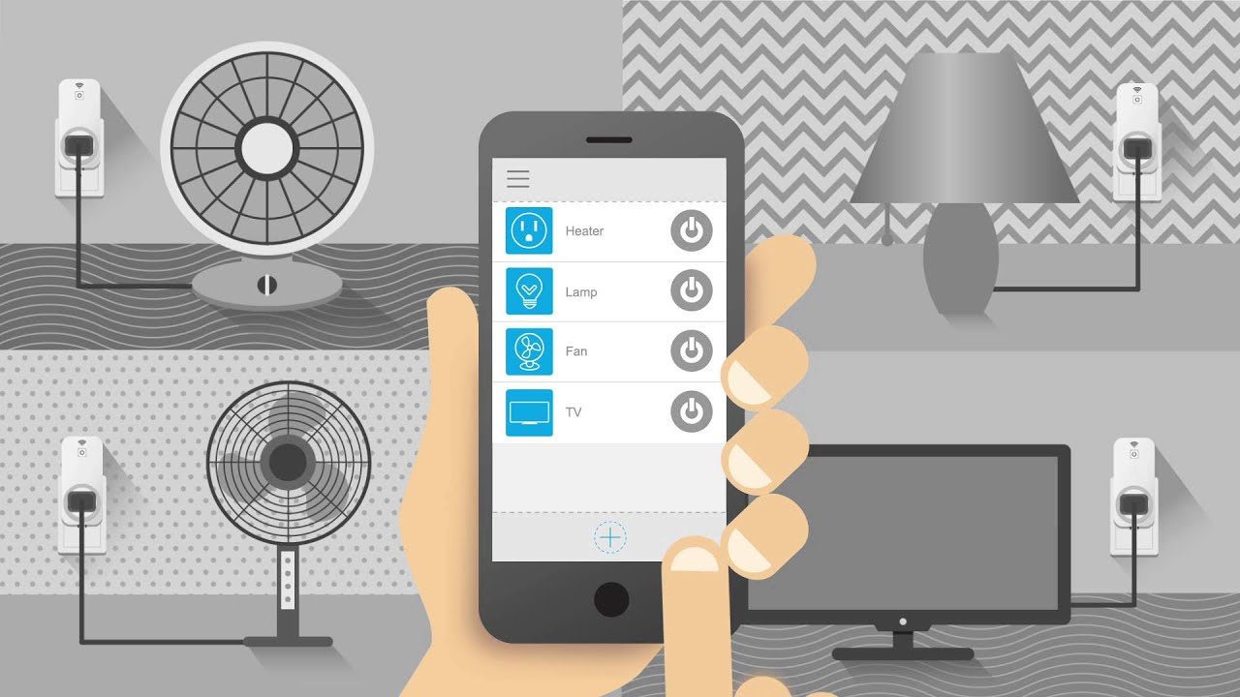
Thank You

